Slide 1

Novelty, Risk and Scientific Uncertainty in Environmental Law
Kathleen Garnett, PhD Candidate
Wageningen University
Law Group

Slide 2

Research Question – Poll Question:
Is existing Environmental law fit for purpose?

Slide 3

EU environmental law
PROTECTION, PREVENTION, PRECAUTION
Article 191 (2) TFEU,
Union policy on the environment shall aim at a high level of protection taking into account the diversity of situations in the various regions of the Union. It shall be based on the precautionary principle and on the principles that preventive action should be taken, that environmental damage should as a priority be rectified at source and that the polluter should pay.

Slide 4
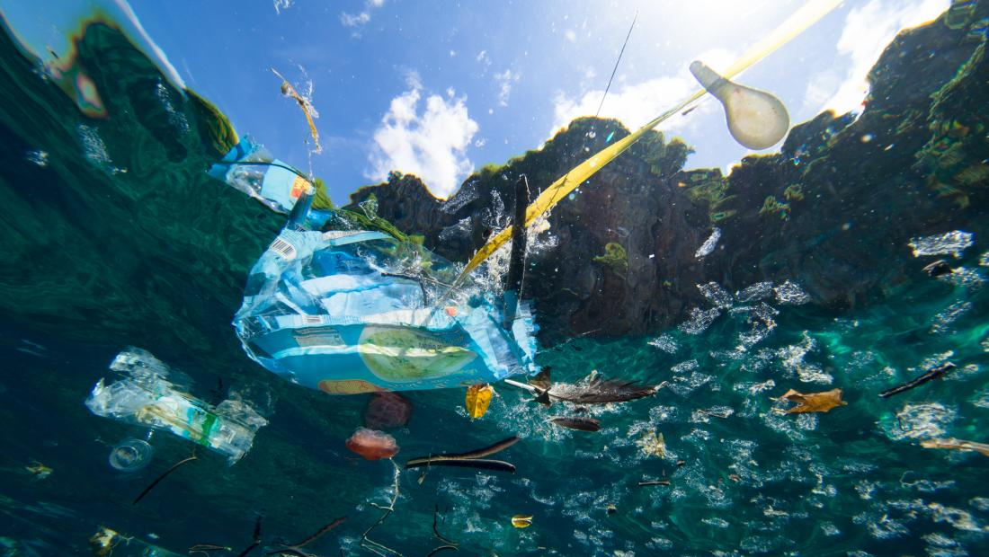
CLIMATE CHANGE,
BIODVIERSITY LOSS,
MICROPLASTICS
GREAT PACIFIC GARBAGE PATCH
AIR, SOIL, WATER POLLUTION
Fifty years of codified Environmental Law

Slide 5
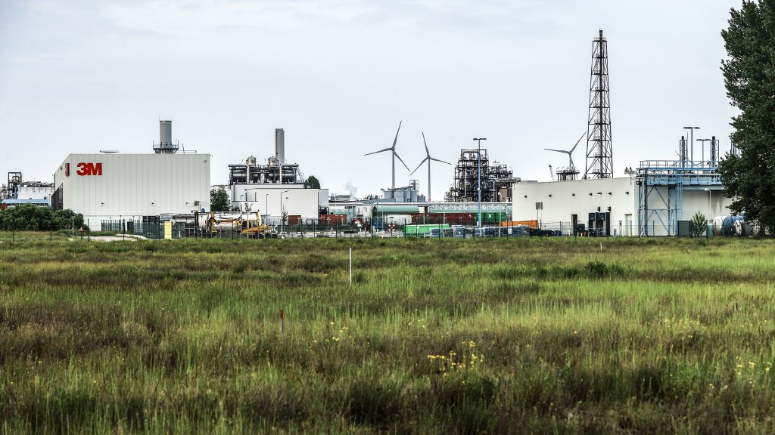
Did environmental law protect regions around Antwerp from the risk of PFAS? Why was the risk not prevented? Did regulators act with caution?
THE VAST AMOUNT OF BELGIAN, DUTCH, EU, NORTH AMERICAN INDEED GLOBAL POLLUTION FROM THIS ONE GROUP OF CHEMICALS ALONE SUGGESTS ENVIRONMENTAL LAW IS FAILING TO PROTECT POPULATIONS FROM THROUGH PREVENTION AND CAUTION.
WHY?

Slide 6

What lies around the corner?
Did the defendant foresee the harm? Was the defendant able to prevent it? Should they have prevented it?
Did the defendant take sufficient measures to protect the claimant(s)?
THE IMPORTANCE OF FORESEEABILITY TO ENVIRONMENTAL LAW

Slide 7


The claims discussed in the case of radium are similar to every single novel, Anthropogenic product, process or substance that has led to significant environmental and public health harm:
PFAS, DDT, aldrin, fluorocarbons, endocrine disruptors, burning of fossil fuels…
Bear in mind …

Slide 8
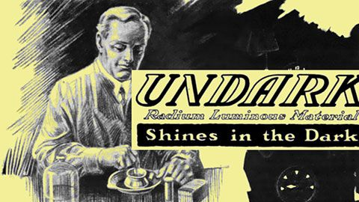
The Enlightening case of Undark: The UNFORESEEABLE danger of radium.
La Porte v United States Radium Corporation, 13 F, 263 (D.N.J.) 1935 Fae. (La Porte).

Slide 9
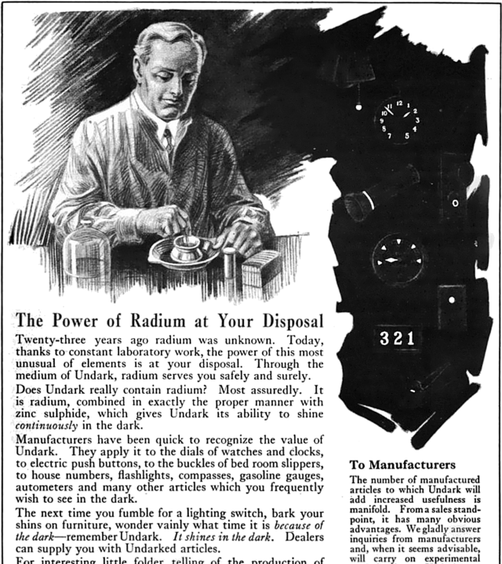
United States Radium Corporation, 1921
THREE CLAIMS
Claim 1: Novelty
“Twenty-three years ago radium was unknown.”
Claim 2: Scientific certainty
“Today, thanks to constant laboratory work, the power of this most unusual of elements is at your disposal.”
Claim 3: Safety
“Through the medium of Undark, radium serves you safely and surely.”

Slide 10
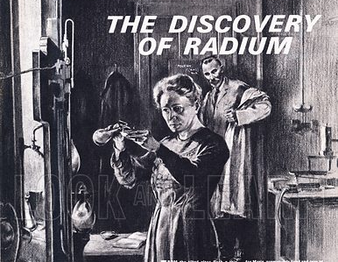

1.NOVELTY
In 1898 the Curries discover the element radium
“The responsibility in this case can only be laid to the tremendous progress made in science in the last four decades, for radium was unknown prior to 1898. Foreman J, La Porte
Twenty-three years ago radium was unknown.

Slide 11
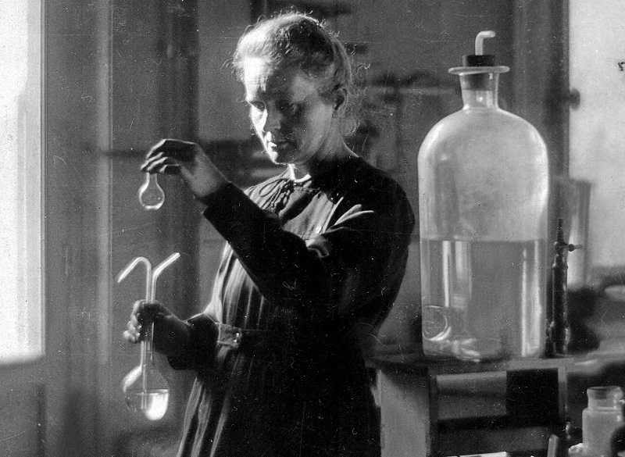
2. Scientific Claims
SCIENTIFIC IGNORANCE of CAUSAL RELATIONSHIPS leading to SCIENTIFIC UNCERTAINTY
Today, thanks to constant laboratory work, the power of this most unusual of elements is at your disposal.
“Going back to 1920, there was no knowledge that an occupational hazard existed in dial painting.”
“It is doubtful if an accurate picture of the knowledge existing in 1920 concerning radium could be drawn even by experts”
Foreman J, La Porte

Slide 12

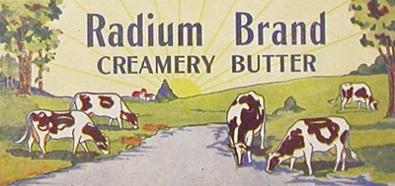

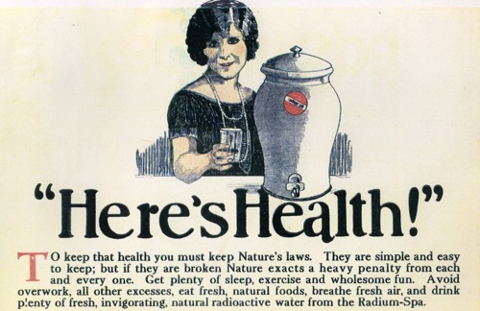
3. Safety Claims
“…..many hailed it as a great boon to humanity, and its internal uses by injection, inhalation, etc., were frequently advocated” Foreman J, La Porte
Through the medium of Undark, radium serves you safely and surely

Slide 13
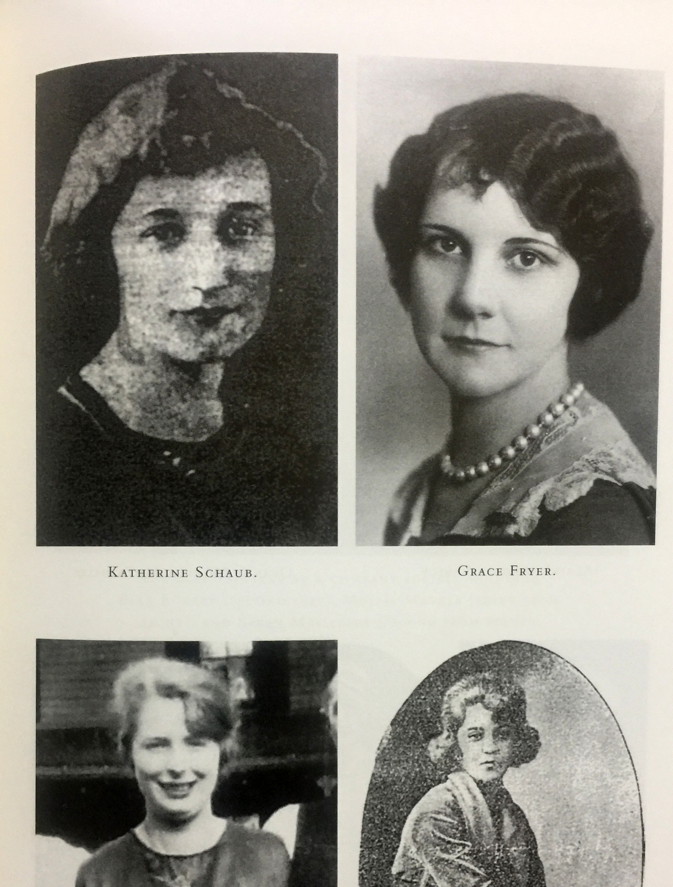
The development of the law to meet such contingencies must of necessity lag behind their discovery. Only forward looking, intelligent legislation can protect future situations such as the one here presented.”
Foreman J, La Porte v United States Radium Corporation, 13 F, 263 (D.N.J.) 1935 Fae.

Slide 14

The birth of Statutory Environmental Law 1962
Fast forward thirty years from the case of La Porte and there is still, forward looking, intelligent regulation to protect the public interest from harm.

Slide 15
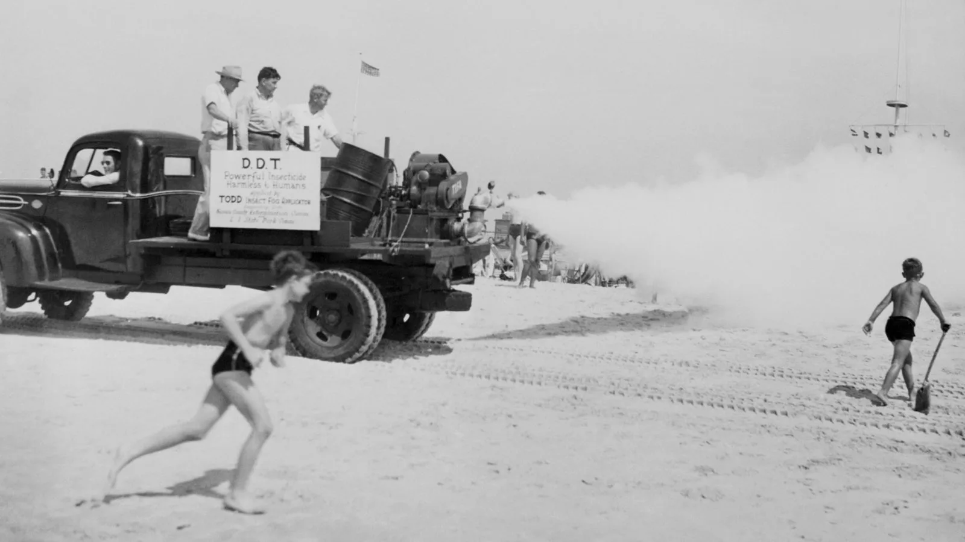
1962 Rachel Carson publishes “Silent Spring”
She is generally credited with “launching the [modern] environmental movement”— by calling attention to risks of chemicals in environment, Naomi Oreskes

Slide 16
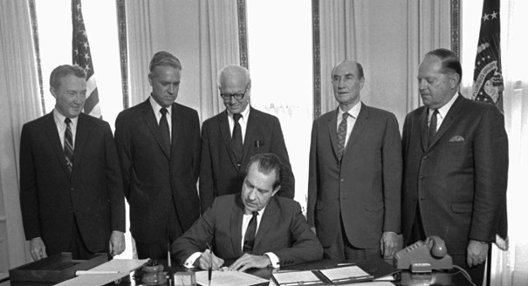
1969 the National Environmental Policy Act (NEPA);
1970 The Clean Air Act (CAC);
1972 The Clean Water Act;
1973 The Endangered Species Act;
1976 The Toxic Substances and Control Act.
President Nixon signing the Endangered Species Act in 1973.
Creation of watchdog agencies to act as independent experts capable of creating protective safety regulations and prevent environmental harm from arising in the first place.
Environment Protection Agency (EPA),
Food and Drugs Administration (FDA),
Toxic Substance and Chemicals Agency (TSCA)

Slide 17


“[T]he ultimate facts here in dispute are ‘on the frontiers of scientific knowledge’, the factual finger points, it does not conclude” The Society of the Plastics Industry, Inc v OSHA, 509 F2d 1301, 1308 (2d
Cir 1975)
How to set environmental standards in cases of novelty?

Slide 18

“How else can [the watchdog agencies] act, given a mandate to protect the public health but only a slight or non-existent data base upon which to draw?” Ethyl Corp.
How to set environmental safety standards in case of scientific uncertainty?

Slide 19

Substantial evidence test?
How to rely on evidence if there is no evidence due to lack of data?
How to set standards in the face of opposing claims of safety?
“How can the Administrator determine that a risk is a significant risk if he cannot assess risks? Surely reliance on ‘facts' as contemplated by petitioners will provide little guidance” Ethyl Corp.

Slide 20


How to calculate and manage risk in the absence of data, evidence and scientific knowledge?
“The watchdog agencies are unequipped with “unequipped with crystal balls and unable to read the future, [but] are nonetheless charged with evaluating the effects of unprecedented environmental modifications, often made on a massive scale.” Ethyl Corp. v. Environmental Protection Agency, 541 F.2d 1 (D.C. Cir. 1976)
Answer: They can’t. They can only speculate or gaze into a crystal ball.

Slide 21
The birth of the precautionary principle in environmental law : we cannot see what lies around the corner
“A statute allowing for regulation in the face of danger is, necessarily, a precautionary statute. Regulatory action may be taken before the threatened harm occurs; indeed, the very existence of such precautionary legislation would seem to demand that regulatory action precede, and, optimally, prevent, the perceived threat.”
Ehtyl Corp [1976]

Slide 22
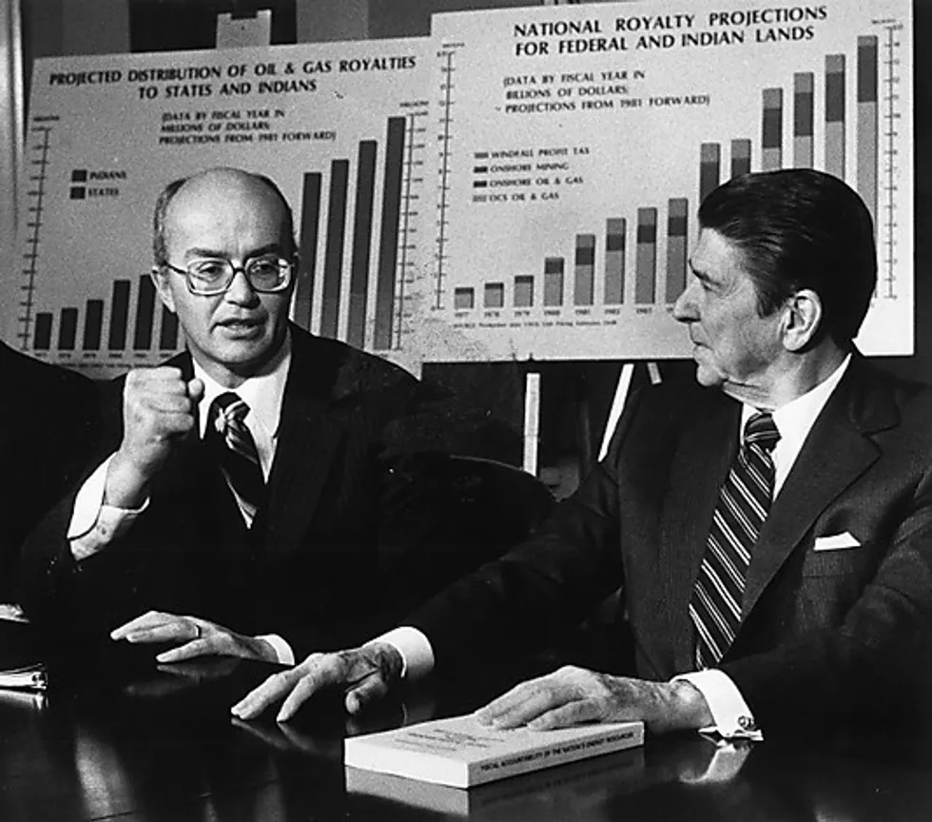
Reaganomics kills precaution
Environmental law based on risk, hazard and cost-benefit-analysis
RELYING ON PHANTOM NUMBERS

Slide 23

Inspired by Reagan approach to environmental safety setting the EU creates a series of
Risk Agencies
2002 - European Food and Safety Authority (EFSA)
2007 - European Chemical Agency (ECHA)
EU begins to set up a technocratic Administrative State based on “sound science”

Slide 24

Let’s Play PFAS Russian Roulette!
Putting PFAS to the Frontiers of Science Test

Slide 25
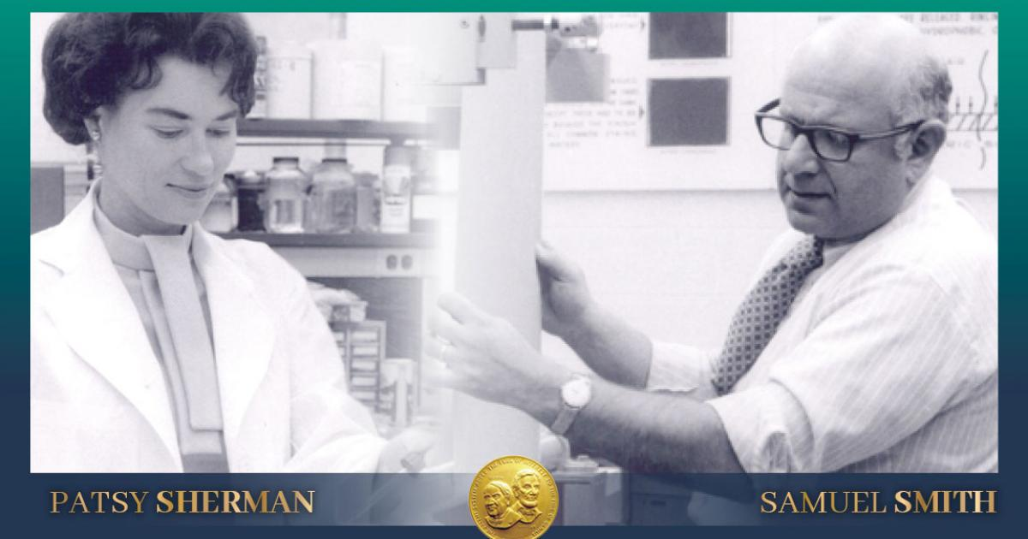
1. Are PFAS, like radium a novel discovery and invention?
Yes.
PFAS are an industrial, chemical substance.
There is no recorded history of their use prior to 1940.
“Processes to commercially produce PFAS were first developed in the 1940s. In the 1950s, 3M was able to use these processes to begin manufacturing various PFAS, including PFOA and PFOS—two types of PFAS—for product applications. In the 1950s, 3M launched several products based on PFAS, including Scotchgard™.” (3M website)
The inventors of Scotchguard: “A happy accident” and featured on “The National Inventors Hall of Fame”
https://www.invent.org/blog/inventors/patsy-sherman-samuel-smith

Slide 26
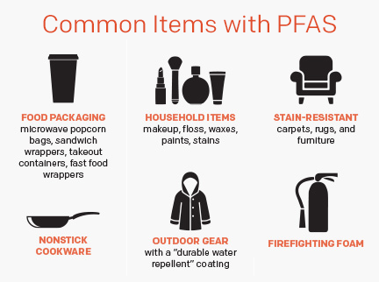
1. Were PFAS, like radium commercialized and put into everyday goods?
Yes.

Slide 27
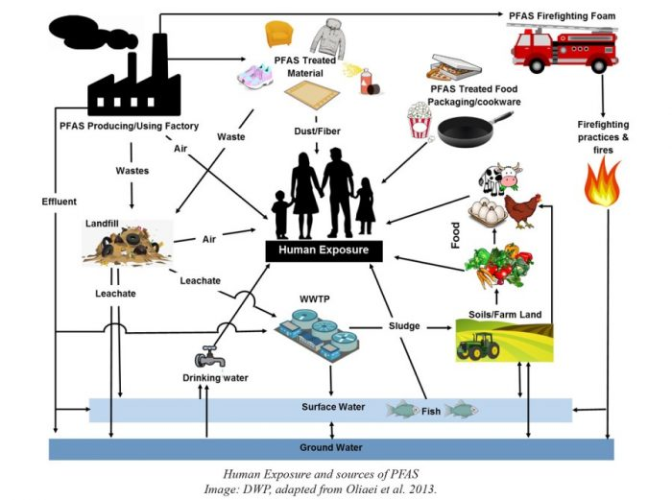
2. Was there sufficient scientific knowledge between use and effect to infer safety when they were first used for widespread commercial use?
No.
Like radium PFAS are novel and therefore when first commercialized untested.
Initially no available facts = no substantial evidence.
Initial safety claims speculative not certain
It took decades to know that they PFAS are persistent, bio accumulative, and toxic
“The ultimate facts [with regard to safety claims] here in dispute are ‘on the frontiers of scientific knowledge’, the factual finger points, it does not conclude”

Slide 28
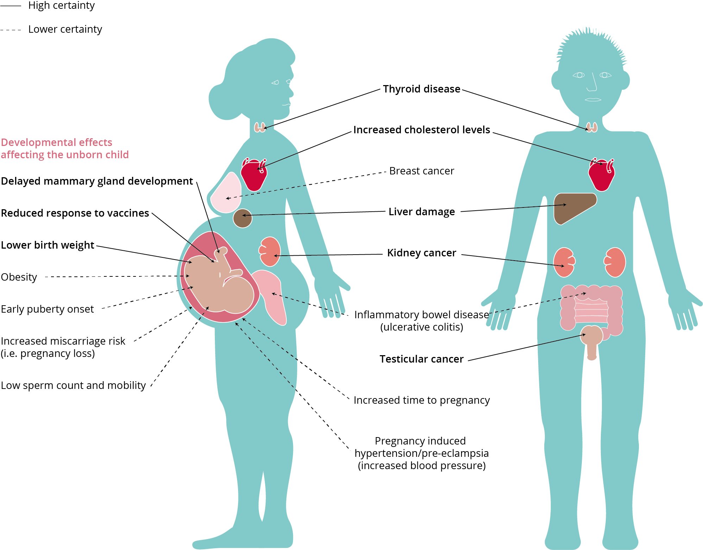
3. Was there sufficient data on PFAS for risk analysists to predict future harm or for toxicologists to propose fit for purpose control measures?
No.
There was no data when they were first commercialised. Risk assessments based on phantom figures not hard figures.
“How can the Administrator determine that a risk is a significant risk if he cannot assess risks? Surely reliance on ‘facts' as contemplated by petitioners will provide little guidance” Ethyl Corp.
Image European Environment Agency
“Emerging Chemical Risks in Europe” PFAS

Slide 29
4. Were existing environmental regulations able to prevent the harm from materialising?
No.

Slide 30
Where is the factual finger pointing?
On the balance of probabilities it is more likely than not that novel, industrial products, processes and substances and processes made by man are inherently high-risk and harmful to the public health, to workers to biodiversity and to the environment

Slide 31
1. Failure of environmental law to understand the conditions that give rise to scientific uncertainty. Industrial novelty.
To conclude….

Slide 32
2. Failure of environmental law to understand the inherent risk to the environment from novel, anthropogenic and industrial substances.

Slide 33
3. Failure to apply the precautionary principle as originally intended.

Slide 34
4. Failure of environmental law to manage the risk of novel, industrial risks based on essential use principles only.

Slide 35
CLIMATE CHANGE,
BIODVIERSITY LOSS,
MICROPLASTICS
GREAT PACIFIC GARBAGE PATCH
AIR, SOIL, WATER POLLUTION
Result of fifty years of flawed environmental law

